Slide 1
Analyzes of shopping malls in Washington

Slide 2
Business Problem
Analyze and select the best locations in the city of Washington to open a new shopping mall. Using data science methodology and machine learning techniques like clustering, this project aims to provide solutions to answer the business question:
In the city of Washington, if a property developer is looking to open a new shopping mall, where would you recommend that they open it?

Slide 3
Data
To solve the problem, we will need the following data:
• List of neighborhoods in Washington. This defines the scope of this project, which is confined to the city of Washington.
• Latitude and longitude coordinates of those neighborhoods. This is required to plot the map and to get the venue data.
• Venue data, particularly data related to shopping malls. We will use this data to perform clustering on the neighborhoods
Source https://en.wikipedia.org/wiki/List_of_cities_and_towns_in_Washington

Slide 4
Methodology
Web scrapping Wikipedia to get the list of towns in Washington
Get latitude and longitude using geopy
Use Foursquare API to get venue data
Group data by neighborhood and taking the mean of the frequency of occurrence of each venue category
Filter venue category by shopping mall
Perform clustering on the data by using K-Means
Visualize the clusters on the folium map

Slide 5
Results
• Cluster 0: Neighborhoods with High number of shopping malls
• Cluster 1: Neighborhoods with low number of shopping malls
• Cluster 2: Neighborhoods with moderate number of shopping malls

Slide 6
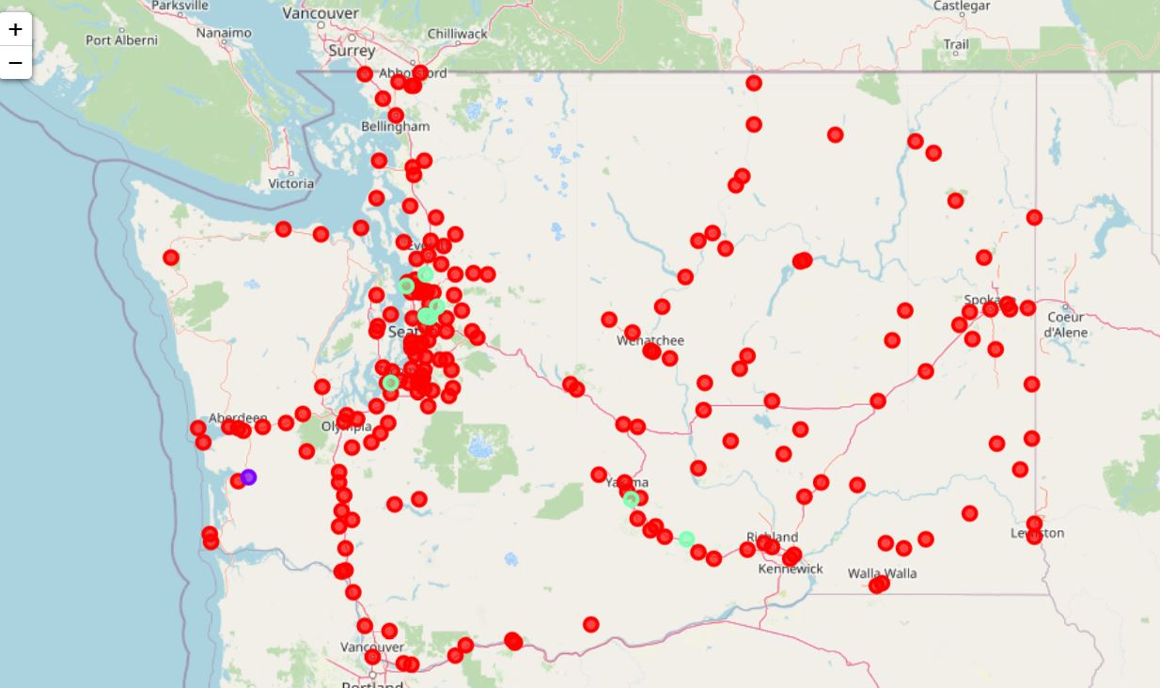
Clustering map

Slide 7
Discussion
most of the shopping malls are concentrated in the central area of Washington
The highest number in cluster 0 and moderate number in cluster 2. On the other hand, cluster 1 has very low number to no shopping mall in the neighborhoods

Slide 8
Recommendation
In cluster 1,open new shopping malls as there is very little to no competition from existing malls

Slide 9
Conclusion
To answer the business question that was raised in the introduction section, the answer proposed by this project is: The neighborhoods in cluster 1 is the most preferred locations to open a new shopping mall

